Slide 1

AI-Based Freelance-Startup System Progress Presentation
Week 05

Slide 2

01 Project Positioning
02 Weekly Progress
2.1 Core Backend Services
2.2 AI & Intelligent Layer
2.3 Infrastructure & System Integration
2.4 Frontend Layer
03 Planning and Next Steps
Contents
CATALOGUE

Slide 3


01 Project Positioning

Slide 4
Current Phase
C
Phase 1: Intelligent Foundation
Focus: System Design and Core Architecture
Goal of Week 04: Complete the implementation of this phase
C
Phase Tasks:
AI Recommendation Tool (Candidate Match)
Profile Analyzer Tool
AI Predictive Tool
Selection and Mission Update
Mission Deployment Real -Time notification system
Profile Engineering and Authentication

Slide 5
Weekly Objective
01
Complete the Objectives of Each Service
Ensure all microservices (Mission, Analytics, AI Orchestrator, etc.) fully implement their planned functionalities for Phase 1.
02
Improve the Objectives of Each Tool
Improve and test tools (Profile Analyzer, AI Recommendation modules) to meet functional requirements.
02
Integrate Frontend with Backend
Connect the frontend interface to the backend services for all features developed in this phase, enabling end-to-end functionality.

Slide 6
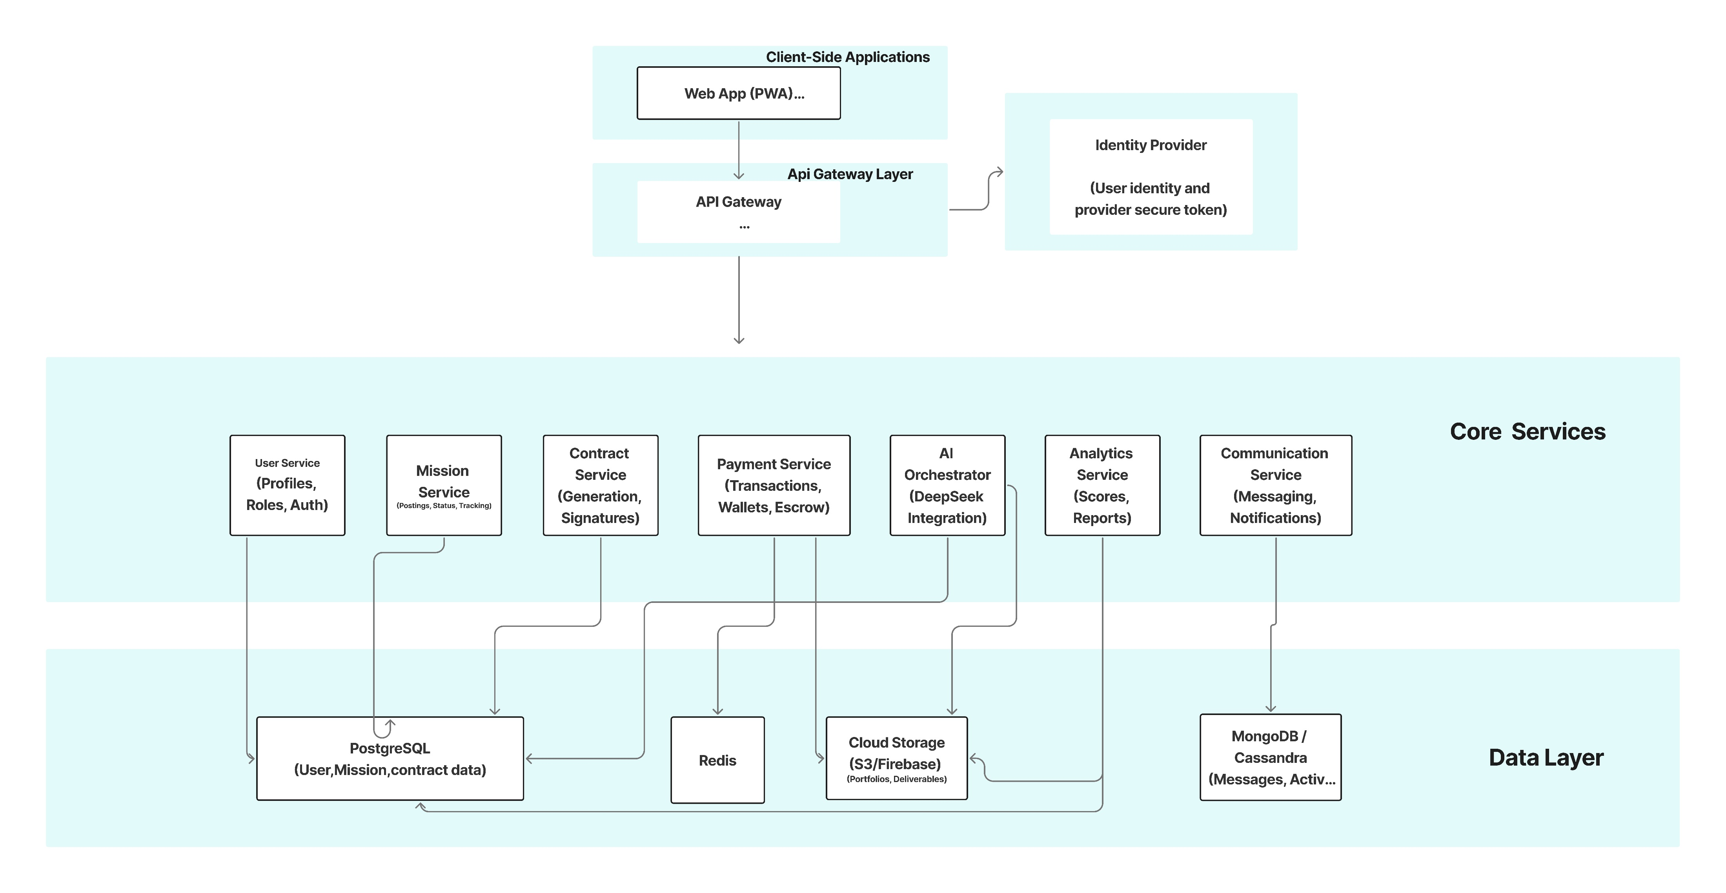
Project Architecture

Slide 7

02 Weekly Progress

Slide 8
2.1 Core Backend Services
User Service
Authentication:
Developed Login and Sign up endpoints secured with JWT-based Authentication.
1
Startup Profile Engeneiring:
Implemented profile management endpoints of profile.
Enable profile retrieval using authenticated user token.
2
Automatic Role initialization:
Designed a role initialization component to automatically seed roles in the PostgreSQL database at service startup .
3

Slide 9
2.1 Core Backend Services
Mission Service
Mission Retrieval and Filtering:
Developed a backend API to fetch missions of company.
1
Auto-Termination Logic:
Implemented a timeout function to automatically closed missions that exceed their set duration.
2
Update Publish Mission:
Update publish mission feature to support secure access using JWT authentication.
3
Real -Time notification system:
Developed a Real-Time Notification System that instantly delelivers Ai matching result to both companies and freelencers.
4

Slide 10
2.1 Core Backend Services
Analytics Service
Reviews Management :
Submit, view, and report reviews between freelancers and startups after missions
1
Analytics Freelancer:
Full statistics and dashboard (ratings, success rate, performance score)
Automatic recalculation after each new review.
2
AI Match Scores :
Process AI scores and return ranked freelancers per mission.
3

Slide 11
2.1 Core Backend Services
Contract Service
Contract Management:
Auto-Generation: Automatically creates a contract when a mission is assigned to a freelancer, preventing duplicate contracts.
Terms Generation: Dynamically generates standard legal contract terms (scope, payment, IP, dispute resolution) based on mission data.
Status Updates: Allows updating contract status (Active, Completed, Cancelled) with optional reasons and timestamps.
1

Slide 12
2.1 Core Backend Services
Contract Service
Contract Management:
Auto-Milestone Creation: Intelligently generates milestones based on mission duration ( 1 milestone for ≤7 days, 5 milestones for >14 days ..).
Financial Allocation: Calculates and assigns monetary amounts to each milestone based on configurable weights relative to the total budget.
Timeline Mapping: Automatically calculates and assigns due dates for milestones proportionally across the contract's duration.
Milestone Status Tracking: Provides methods to update individual milestone statuses (Completed, Approved) with completion timestamps.
2

Slide 13
2.2 AI and Intelligent Layer
Integrated Tools
1. Freelancer Tools
search freelancer
get freelancer profile
2. Company and Mission Tools
get company profile
search mission
get mission details
3. AI Matching and Analysis
calculate compatibility score
find best matching mission get matching missions
4. Advanced Deep Analyzers
analyser for freelancer profile

Slide 14
2.3 Infrastructure and System Integration
Containerization:
Dockerized Frontend, Gateway, User Service ,Mission Service and analysis service
1
1
Gateway Routing:
linked User , Mission and Analysis Services to API Gateway
RabbitMQ Messaging:
Asynchronous communication for workflow simulation(mission,analysis,Contract)

Slide 15
2.4 Frontend Layer
Dashboard and Navigation
Role-based dashboard (/dashboard)
Freelancer view: applications and status overview
Company view: missions and applications summary
Sidebar navigation adapted per role
1
1
Application Tracking: (Real Time)
Application status tracking: (Pending, Viewed, Shortlisted, Accepted, Rejected)
Dashboard with counts + detailed list
Near real-time updates via WebSocket (STOMP + SockJS)

Slide 16
2.4 Frontend Layer
1
1
Startup features
Mission Creation
Multi-step “Post Mission” flow (/publish)
Form validation before submission
Deadline input with date and time (normalized format)
Missions Management
Missions overview page (/missions)
Status columns: Open, In Progress, Completed, Closed
Search + quick navigation
Freelancer features
Browse and Apply
Browse missions (/applymission)
Search functionality
Apply with cover letter and proposed rate
AI Suggestions
AI-recommended missions (/ai-suggestions)
Match info (budget, deadline, score)
Apply directly from suggestions

Slide 17

03 Planning and Next steps

Slide 18
Plan for the Next Week
1
Integrate all Phase 1 components into a fully functional system (main objective).
2
Launch Phase 2 and Phase 3 concurrently to accelerate overall development.

Slide 19

Thank you

